Slide 2
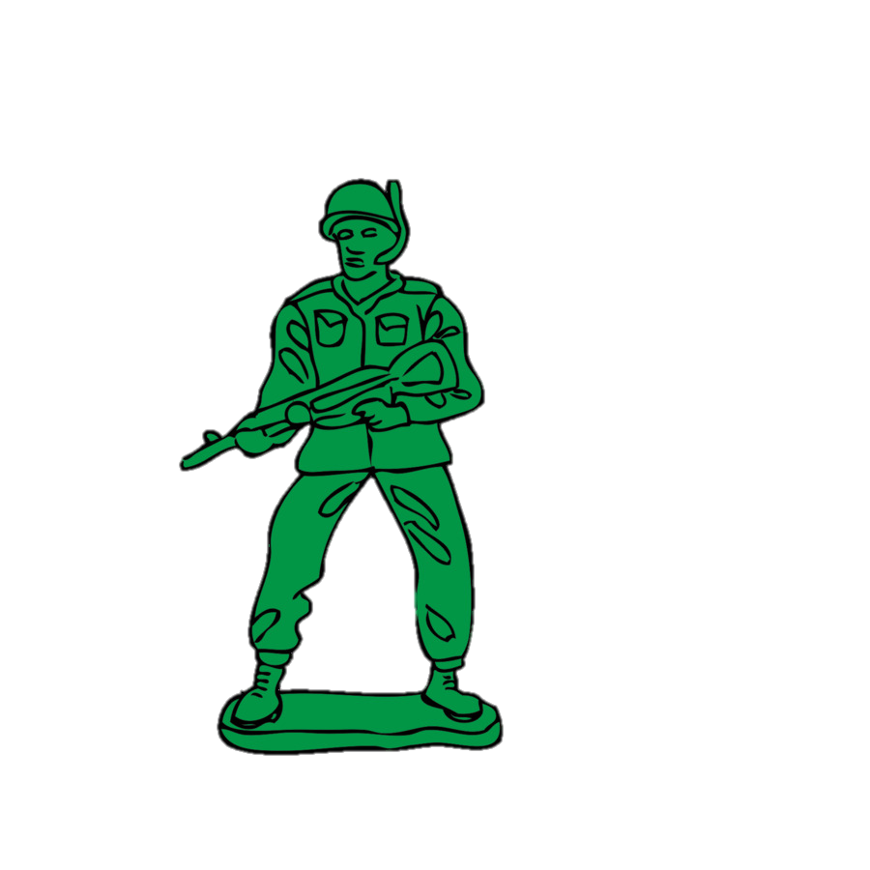
Notes:
In order to make us ill, pathogens have to overcome the body’s defences. Our bodies do loads of things to ward off germs before they cause problems for us, and healthy bodies do contain some levels of pathogens. The problem starts when the pathogens are bigger and stronger than our bodies’ defences.

Slide 4
What is this?
What’s missing?
Notes:
This is what red blood cells look like under a scanning electron microscope. It is a very powerful microscope that allows you to zoom in on really tiny things and see them in great detail. You’d never be able to see this with the naked eye!
Blood contains mostly red blood cells in plasma. Plasma has a thick and runny texture. Blood also contains white blood cells and platelets. You need all of these things to help fight infections.
Children to demonstrate: Huddle together as if they are platelets at the site of a wound on the skin. Gently put a loose-weave net over them to show how fibrin works to form a scab. Demonstrate good practice by using hand sanitiser for this bit: hand marshmallows to the children to represent invading infections. White blood cells protect us against invading pathogens by destroying them before they can cause us harm. They do this in different ways, but one particular type of white blood cell (phagocytes) destroy pathogens by digesting (eating) them. The children can eat the marshmallows to represent how white blood cells destroy pathogens.

Slide 5
Fun fact:
Blood might look nothing more than red and gooey, but did you know there are different blood types?
Our blood type is one of the things we inherit from our parents, and their blood types affect the type of blood we have. We get one blood type gene from each parent. Can you work out what your blood type might be?
 |  | Mother
 |  | A | B | AB | O
Father | A | A or O | A, B or AB | A or AB | A or O
 | B | A, B or AB | B or O | AB or B | B or O
 | AB | A or AB | AB or B | A, B or AB | A or B
 | O | A or O | B or O | A or B | O
Almost 50% of the UK population has the same blood group.
Which group do you think it is?
Notes:
Children can play with the ‘buckets of blood’ on their tables, and decant some into a pot to take home. This could be a fun talking point for families. Children could create a label for their blood using the information, or make it up!

Slide 6
