Slide 1
Digital Calculator
Group Members
Ansar Rasool 2015-EE-80
Qasim Elahi 2015-EE-66
Abdullah Usman Khan 2015-EE-82
Asad Ali 2015-EE-77

Slide 2
Introduction
In this project, we will be performing arithmetic operations by designing a Digital Calculator.
Basic features includes
Addition
Subtraction
Multiplication
Division
Trigonometric functions
Determinant of a matrix
Evaluating a infix expression (Using DMAS)

Slide 3
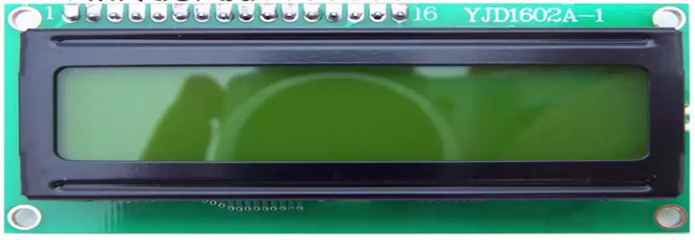
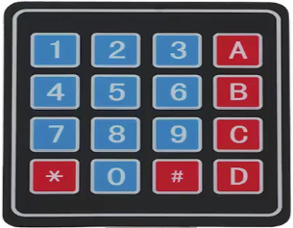
components
TM4C123 Microcontroller
LCD module (20x4)
Keypad (4x4)

Slide 4
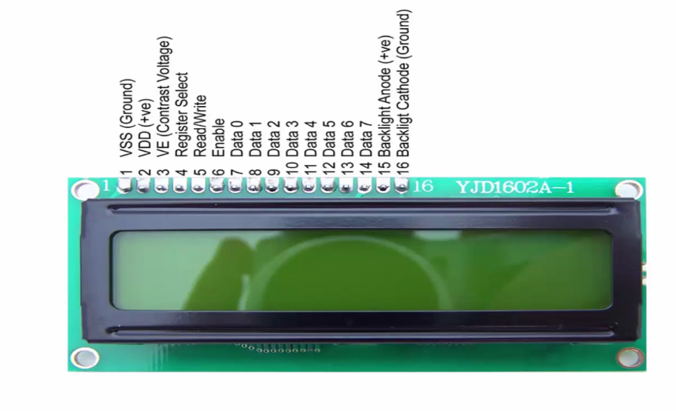
Lcd interfacing
LCD being used -> 20x4 digit LCD
Port used -> Port B for
Data pins of LCD

Slide 6
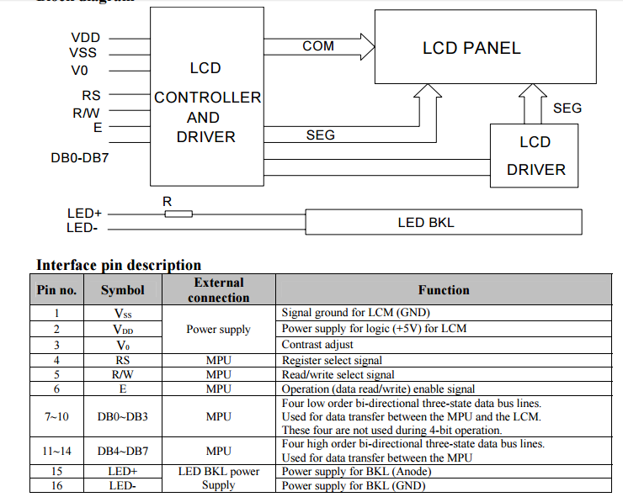
LCD Module 2004A Specifications

Slide 7
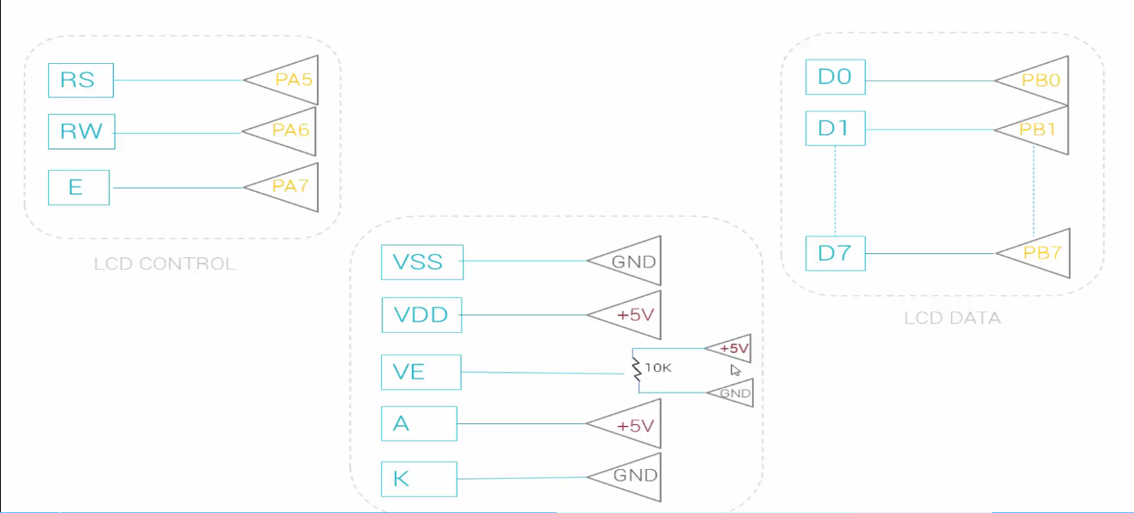

Slide 8
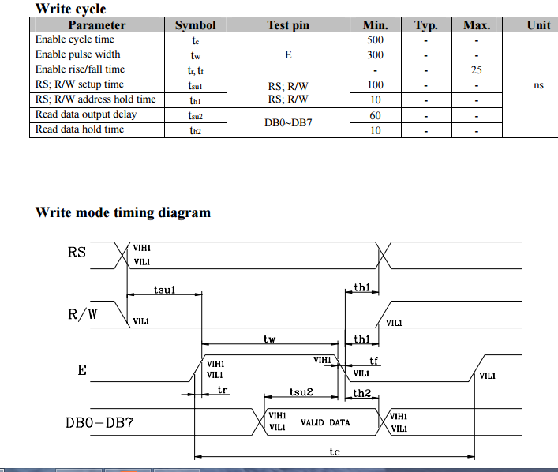
Write Cycle of LCD Controller

Slide 10
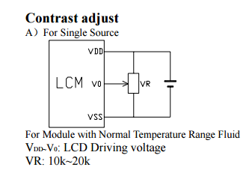
LCD Address scheme Contrast Adjustment

Slide 11
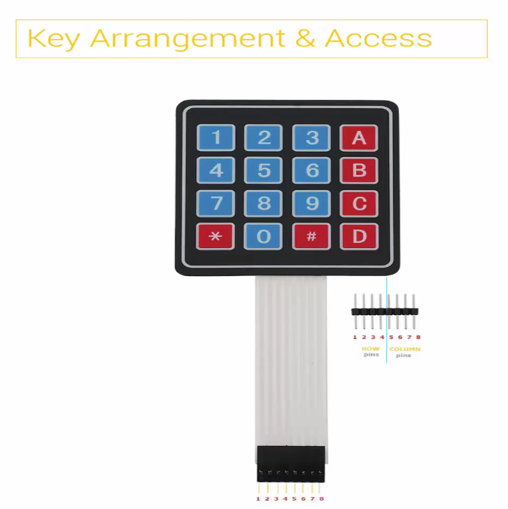
Keypad Interfacing
2 4x4 keypads
GPIO Ports used :
PortC for Rows
PortF for Coloumns

Slide 13
Programming Details..
LCD Initialization

Slide 14
LCD Commands

Slide 15
LCD Data

Slide 16
Keypad programming

Slide 17
Thank You

