Slide 1
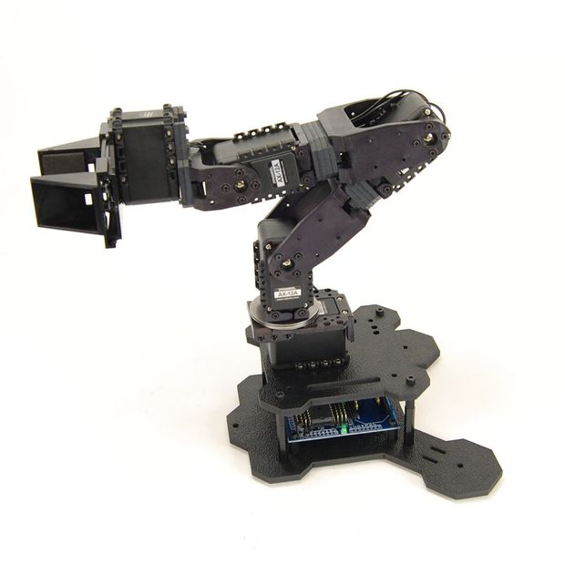
Pallet stacking with PhantomX Pincher
3/4 Pit
Ragnar Jacobsen, Nicolaj Astorp Olsen, Thomas Jonstrup Thomsen

Slide 2
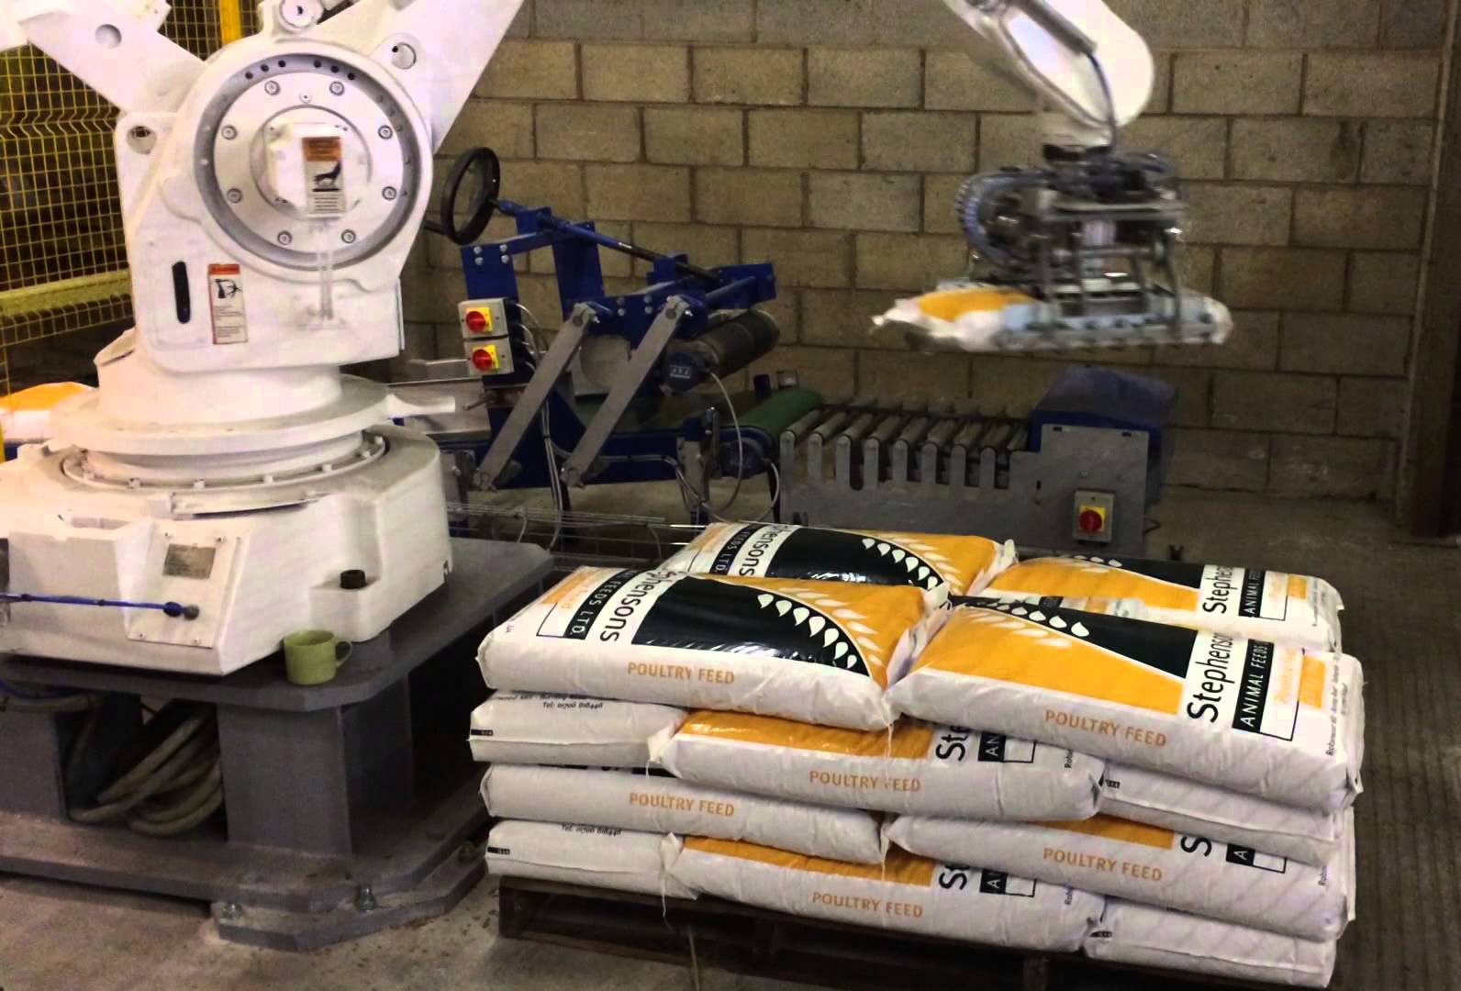
Mission
Creating a robot that can stack objects on pallets
Simulating real industrial task
Understanding space and movement
Learning to use ArbotiX and Pincher

Slide 3
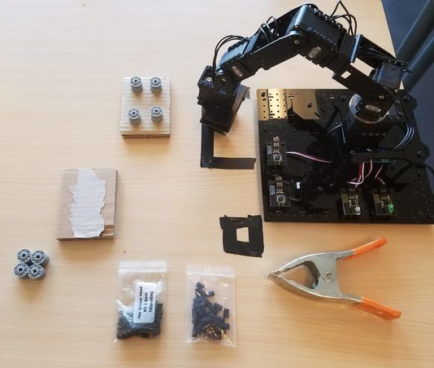
Setup
PhantomX Pincher robot arm on platform
RobotGeek buttons and LED drivers
Pallets and objects
Zones marked with tape
Arm reach limitations

Slide 4
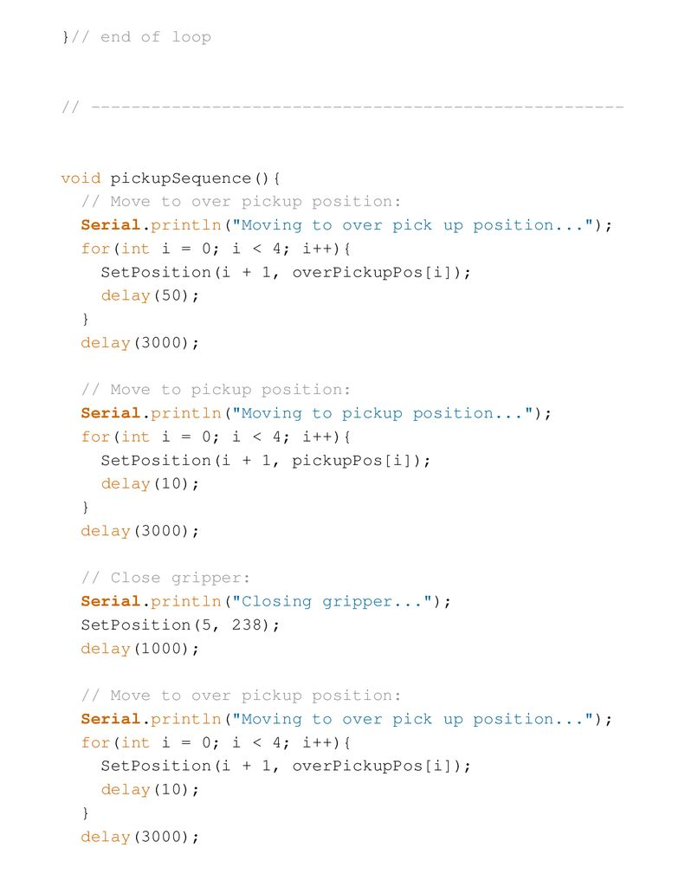
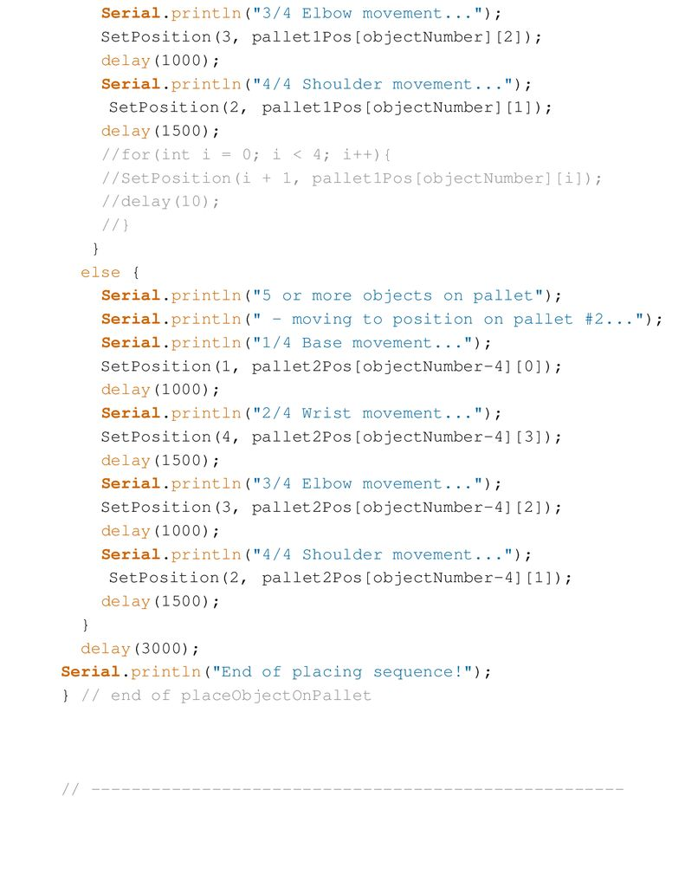
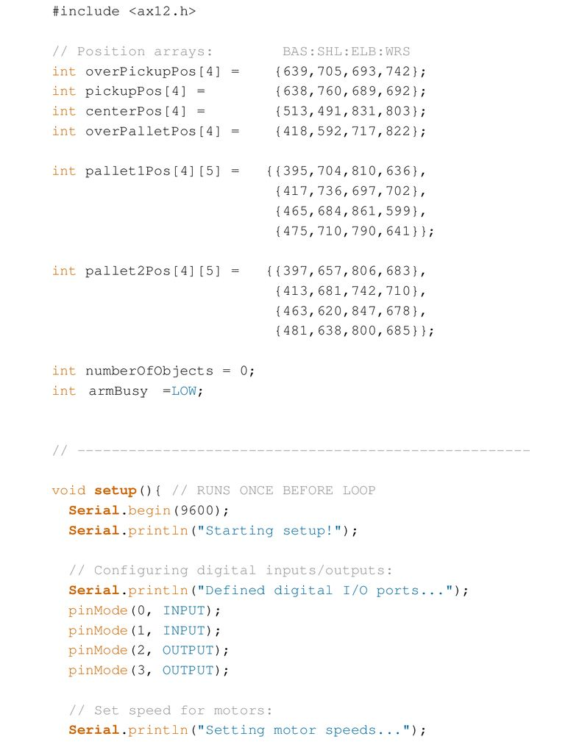
Programming
<ax12.h> library header
Servo speeds with ax12SetRegister2
Positions and object placement with arrays
Movement functions with for loops
Individual arm link SetPosition
Independent gripper control

Slide 5
Challenges and conclusion
Speed registers disappear?
Command? What command?
Faults not reliably replicable
Fixes?
Re-upload program
PincherTest.ino
Reboot
Conclusion:
The program commands the robot correctly for the task, but…
The robot does not always do what the program commands it to do.

Slide 7
Demonstration

