Slide 1
Zoom Car
By:- Harshit Jain
Class-10 B
Roll No.-12

Slide 2
Components you will need:
Geared Motor X 5 (Recycled)
Cardboard X 4sq.feet (Recycled)
Battery X 1
12 Volt DC Adapter X 1 (Recycled)
Button Switch X 6 (Recycled)
2-Way Switch X 1 (Recycled)
Tyres X 4 (Recycled)
Nuts n Bolts X 4 (Recycled)
Battery Cap X 3 (Recycled)
Connecting Wires X 5m (Recycled)

Slide 3
Features:
Foldable:
Bend the frame from 28cm to 16cm
Adjustable:
Frame can be adjusted according to the areas
Eco friendly:
It is powered by electricity

Slide 4
Features :
Shock absorbing frame
Quick: Each wheel is powered by an electric motor
Car sharing

Slide 5
Foldable
It has great capability of folding by reducing the car size from 28cm to16cm.
This folding capability helps the car in easy parking.
This allows to park seven cars in place of four cars , saving space.

Slide 6
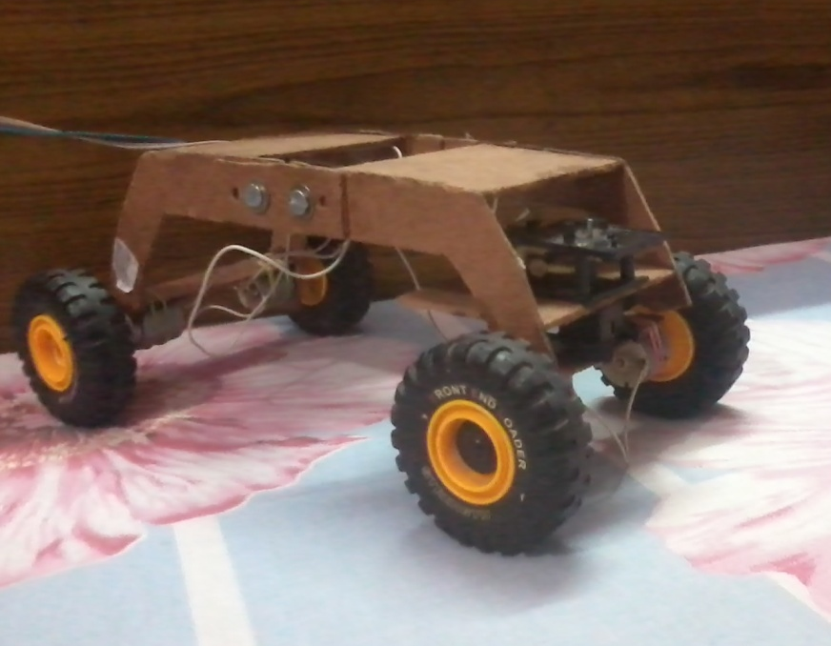
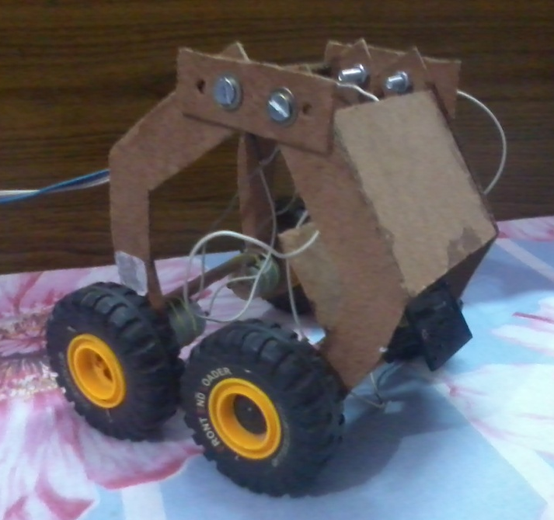
Foldable

Slide 7
Eco-Friendly
The car is eco-friendly because as whole it works on electricity which doesn’t pollute the environment and save resources for future generations.
It is economical to use.

Slide 8
Adjustable
The car can be adjusted according to the areas on which it is running i.e. it can be zoomed.

Slide 9
Shock Absorbing Frame
The Car’s frame is designed so that it can absorb the shock and avoid the car from damaging.

Slide 10
Quick
Car has four of these wheels, which drives the vehicle forward.
The car doesn't have an engine. There are no gears. No transmission.
This is a very efficient way of using energy."

Slide 11
Car Sharing
They can be rented on metro stations and main DTC Bus Terminals.
Batteries can be charged through City’s Power Grid.

Slide 12
“It's about how people move in the city.”
Thank You…

