Slide 1
Modular Construction Project Proposal
By: Asia

Slide 2
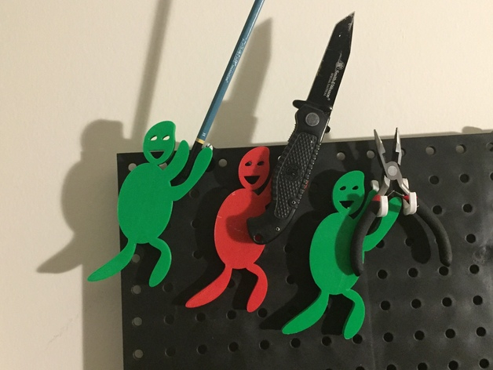
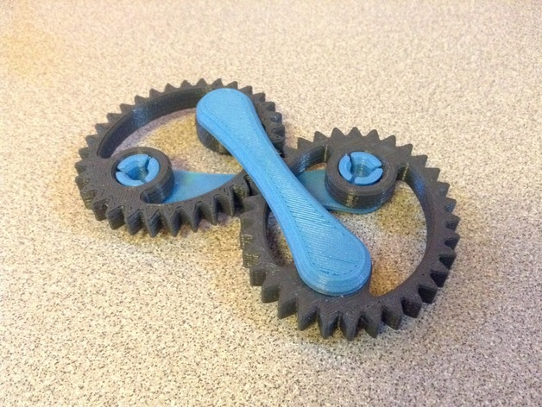
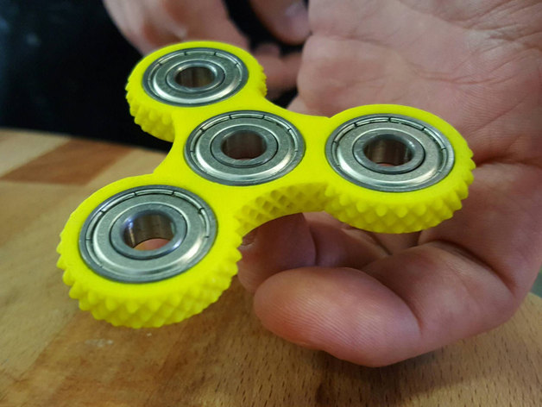
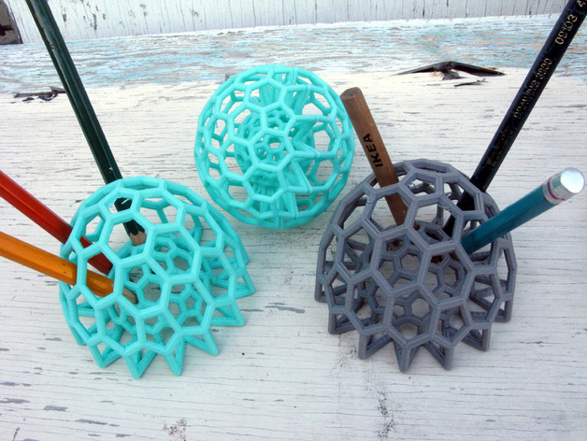
Research from Kickstarter & Thingiverse
Packaging
Products/downloads
Incentives
Selling points
Naming
Notes:
Packaging: simple, cardboard, cans (like Altoid cans)
Products/downloads: download all products so you can use them for yourself, educational videos on how they work and why they created their product. Some incentives are like the higher amount of money you donate the more things you get for yourself like a t-shirt, updates, special thanks.
If someone post a comment or ask a question most answer at least within a week or by the end of the day.
Parts: They name it by what it does and what version
*it is more effective to have brief descriptions and a lot of pictures to keep people interested.

Slide 3
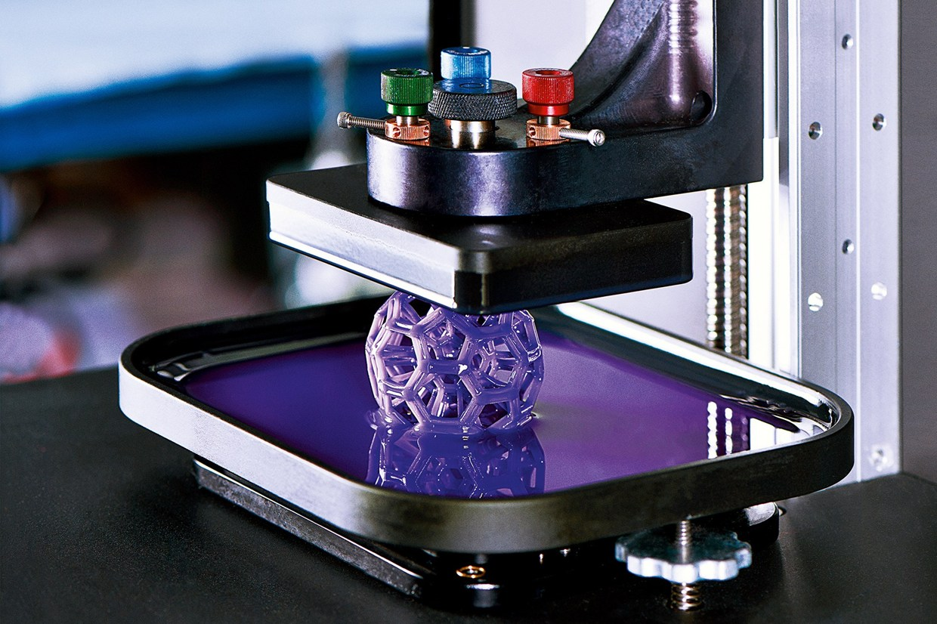
Skills
Expand my creativity
3D printing
Improve OnShape
Notes:
Creativity: I hope to expand my creativity because we have to think of things to build with our materials and how our connecting pieces should look.
3D: I have never used a 3D printer before and I am excited to learn how
OnShape: I hope to improve my skills on OnShape because I have never tried to make a complex design on it

Slide 4
Project Timeline
(March 7-10): some initial models drafted and possibly printed to test from and function
(March 13-17): both connectors finalized and mostly printed
(March 27-31): model kit concept locked and printing the kit contents
(April 3-7): instructions and Bill of Materials completed, finalizing Thingiverse submission, preparing lower school presentation

Slide 5
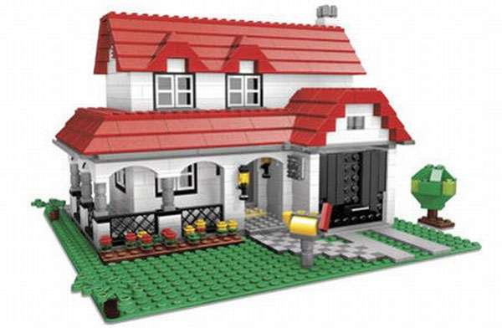
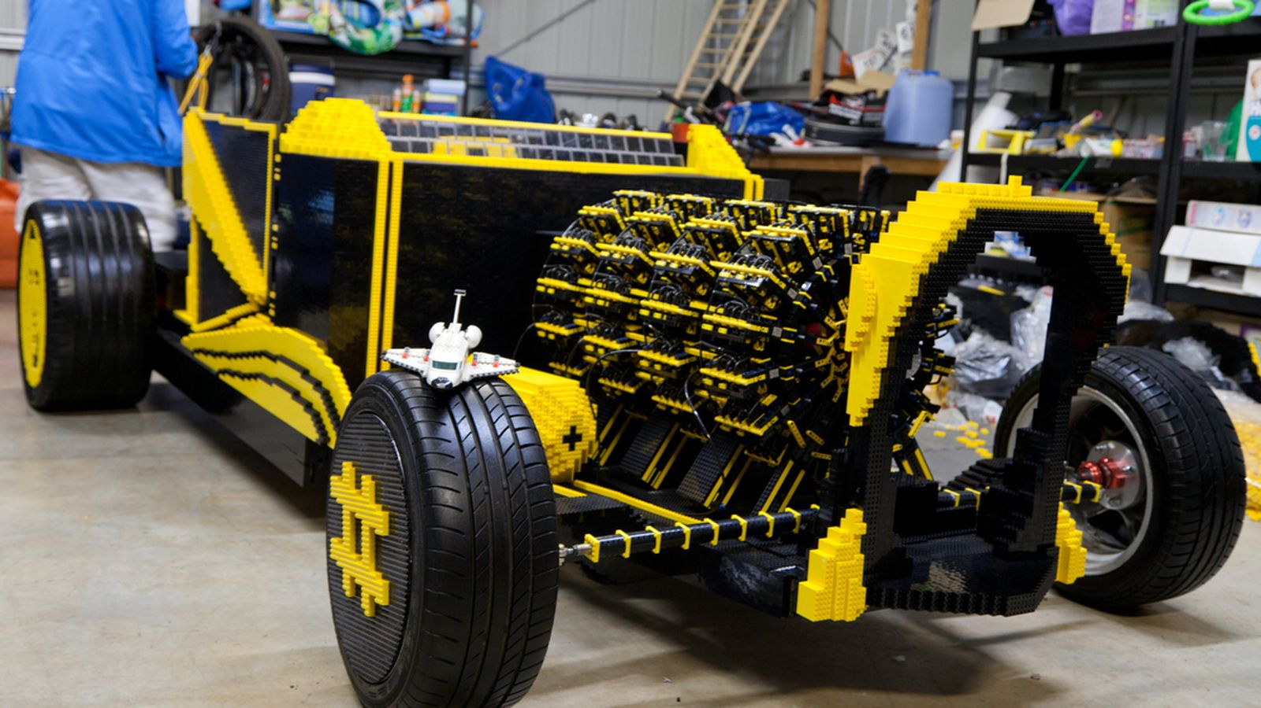
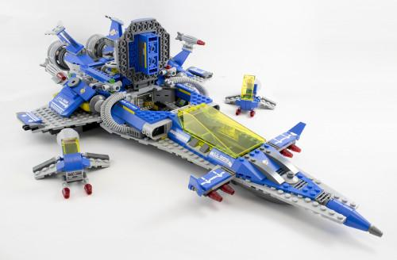
Ideas/Concepts
House/building
Car
Space ship
Notes:
My cheap and available material are pencils that are rounded.
Pegboard: I wanted to use something similar to a pegboard for a base.
I chose these particular structures because that was my go to thing to build as a kid.
I will most likely make my structure a house or a spaceship unless I figure out how to create tires for a vehicle without them falling off.

