Slide 1
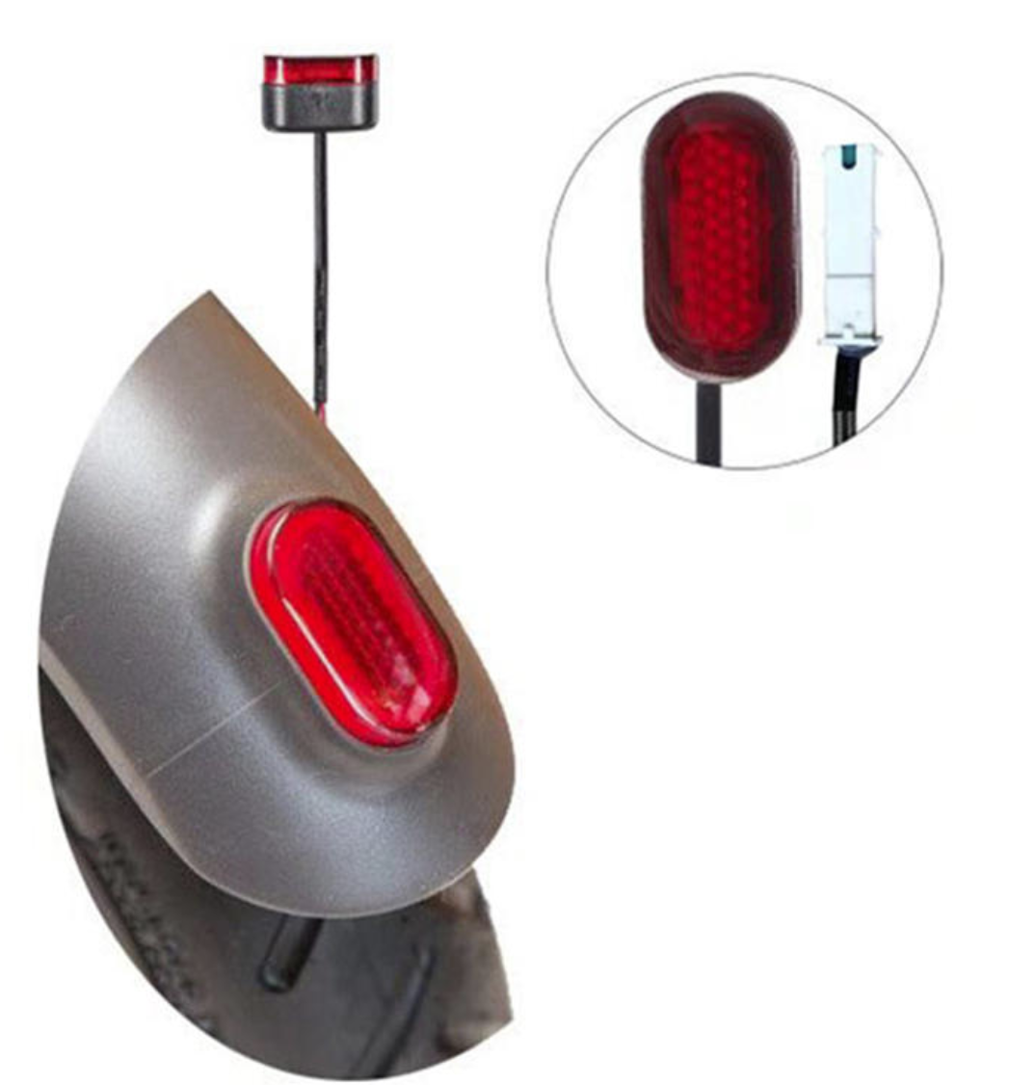
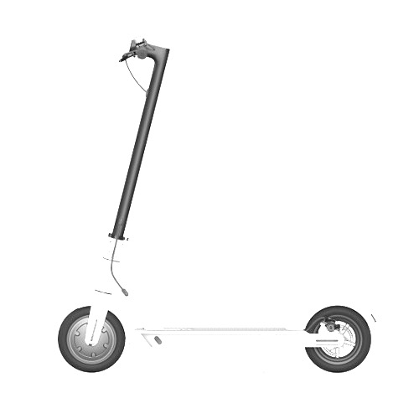
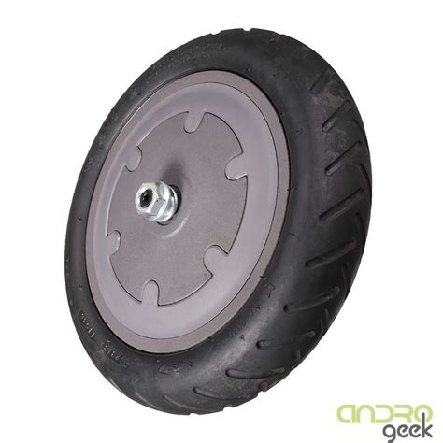
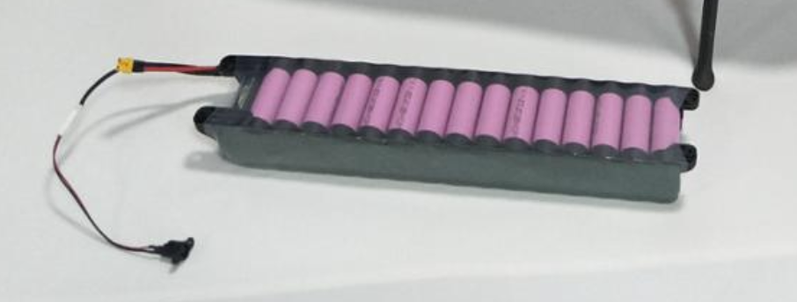
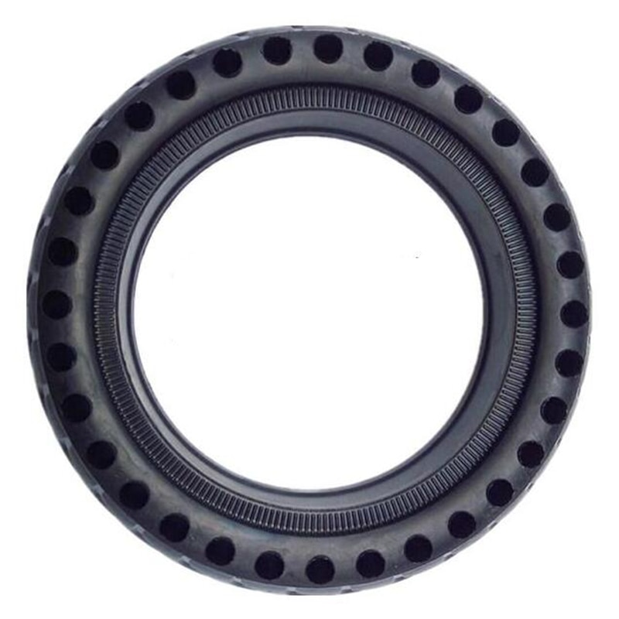
Light: LED/ BULB
Life span: ____
Cost: _____
CO₂ New :_____
CO₂ /km : _____
BRAINSTORMING CARDS
Cut away the cards and discuss different options
What is the most sustainable combination of parts?
Frame: ALU/ Steel
Life span: ____
Cost: _____
CO₂ New :_____
CO₂ /km : _____
MOTOR : 350 / 500 W
Life span: ____
Cost: _____
CO₂ New :_____
CO₂ /km : _____
Batt. : LION / NIMHA
Life span: ____
Cost: _____
CO₂ New :_____
CO₂ /km : _____
tyre: Solid / Tube air
Life span: ____
Cost: _____
CO₂ New :_____
CO₂ /km : _____

