Slide 1
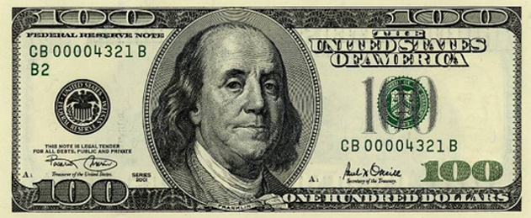
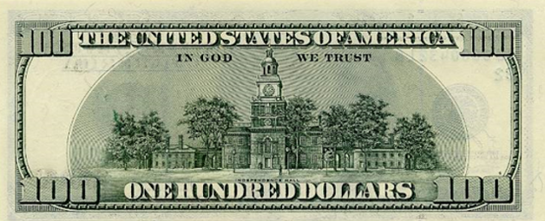

Slide 4
Save a photo head shot onto your computer
Click onto oval image
Go to format / shape Fill / Picture
Go to head shot and double click on it
The photo should now be inserted into the oval
Copy oval with head shot and paste into slide 2
Make 5 more copies of it
Manoeuvre into place over Benjamin's head
Group the photos together – go to format and then group

Slide 6
HUNDREDS
HUNDREDS
HUNDREDS
HUNDREDS
$5,000
$5,000
$5,000
$5,000
$5,000
$5,000
$5,000
$5,000
HUNDREDS
HUNDREDS
HUNDREDS
HUNDREDS
HUNDREDS
HUNDREDS
HUNDREDS
HUNDREDS
HUNDREDS
$5,000
$5,000
$5,000
$5,000
$5,000
$5,000
$5,000
$5,000
HUNDREDS
HUNDREDS
HUNDREDS
HUNDREDS
HUNDREDS
HUNDREDS
HUNDREDS
HUNDREDS
HUNDREDS
$5,000
$5,000
$5,000
$5,000
$5,000
$5,000
$5,000
$5,000
HUNDREDS
HUNDREDS
HUNDREDS
HUNDREDS
HUNDREDS
HUNDREDS
HUNDREDS
HUNDREDS
HUNDREDS
$5,000
$5,000
$5,000
$5,000
$5,000
$5,000
$5,000
$5,000
HUNDREDS
HUNDREDS
HUNDREDS
HUNDREDS
HUNDREDS
HUNDREDS
HUNDREDS
HUNDREDS
HUNDREDS
$5,000
$5,000
$5,000
$5,000
$5,000
$5,000
$5,000
$5,000
HUNDREDS
HUNDREDS
HUNDREDS
HUNDREDS
HUNDREDS
HUNDREDS
HUNDREDS
HUNDREDS
HUNDREDS
$5,000
$5,000
$5,000
$5,000
$5,000
$5,000
$5,000
$5,000
HUNDREDS
HUNDREDS
HUNDREDS
HUNDREDS
HUNDREDS
HUNDREDS
HUNDREDS
HUNDREDS
HUNDREDS
$5,000
$5,000
$5,000
$5,000
$5,000
$5,000
$5,000
$5,000
HUNDREDS
HUNDREDS
HUNDREDS
HUNDREDS
HUNDREDS

