Slide 1
Home-made LINE FOLLWER ROBOT
By: Pranjal Joshi

Slide 2
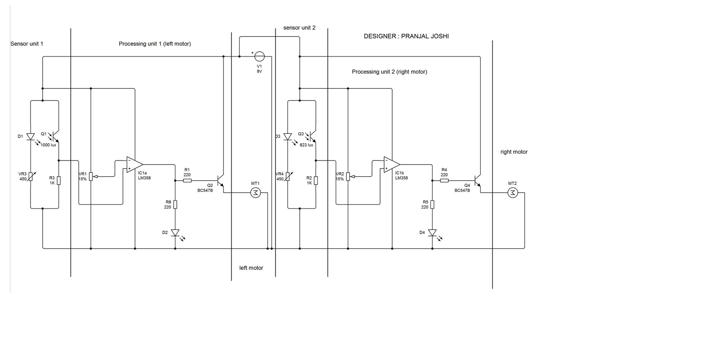
Circuit Diagram:

Slide 3
Components you will need:
LM358 op-amp chip x 1
220 ohm resistor x 4
1k resistor x 2
white LED x 2
Photo-diode x 2
Red LED x 2
Geared motors x 2
BC547B transistor x 2
5k variable resistor x 2
100k potentiometer x 2
9V battery x 1

Slide 4
Logic of working:
Left sensor
Right sensor
LM358
(IC)
Output to left motor
Output to right motor

Slide 5
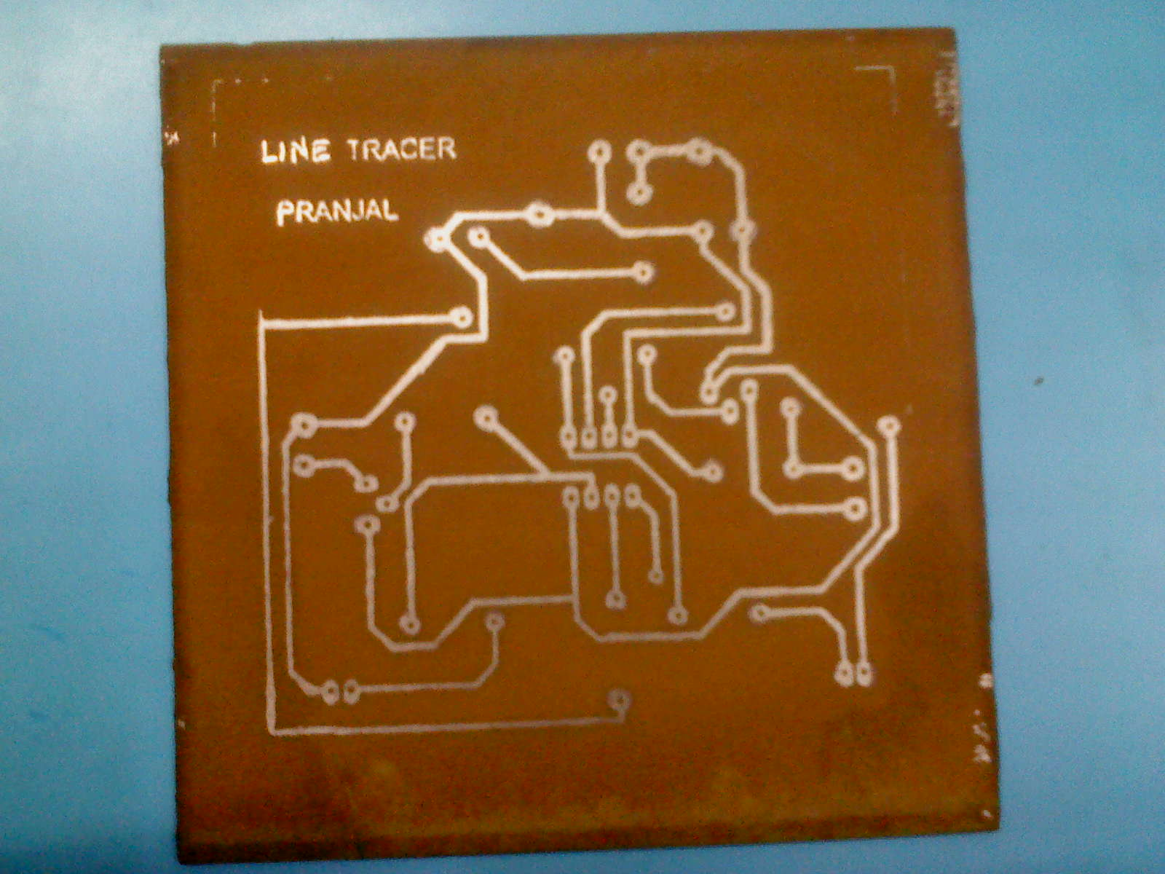
Making a
printed circuit board

Slide 6
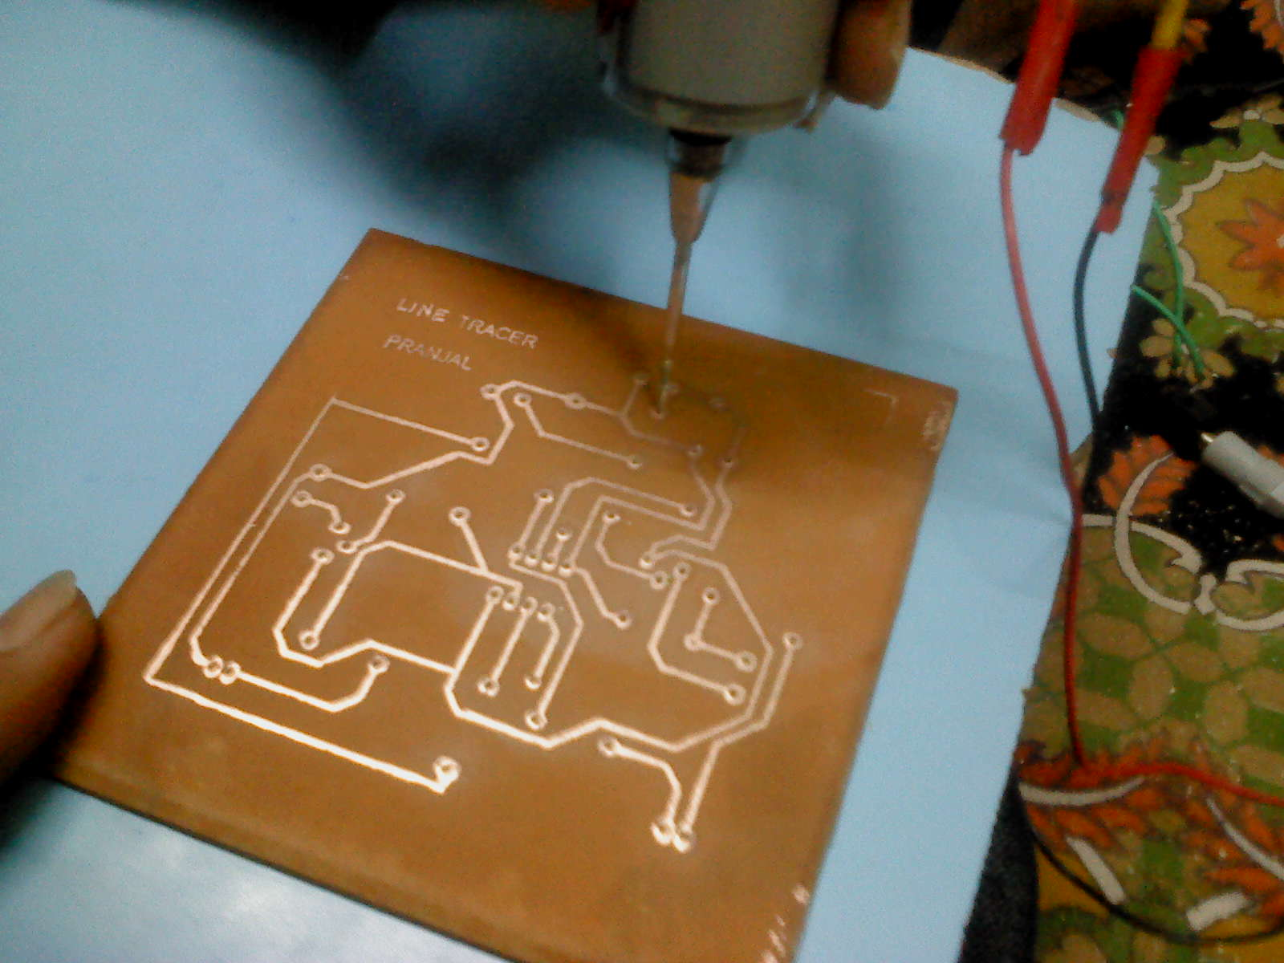
Drilling with home made drill

Slide 7
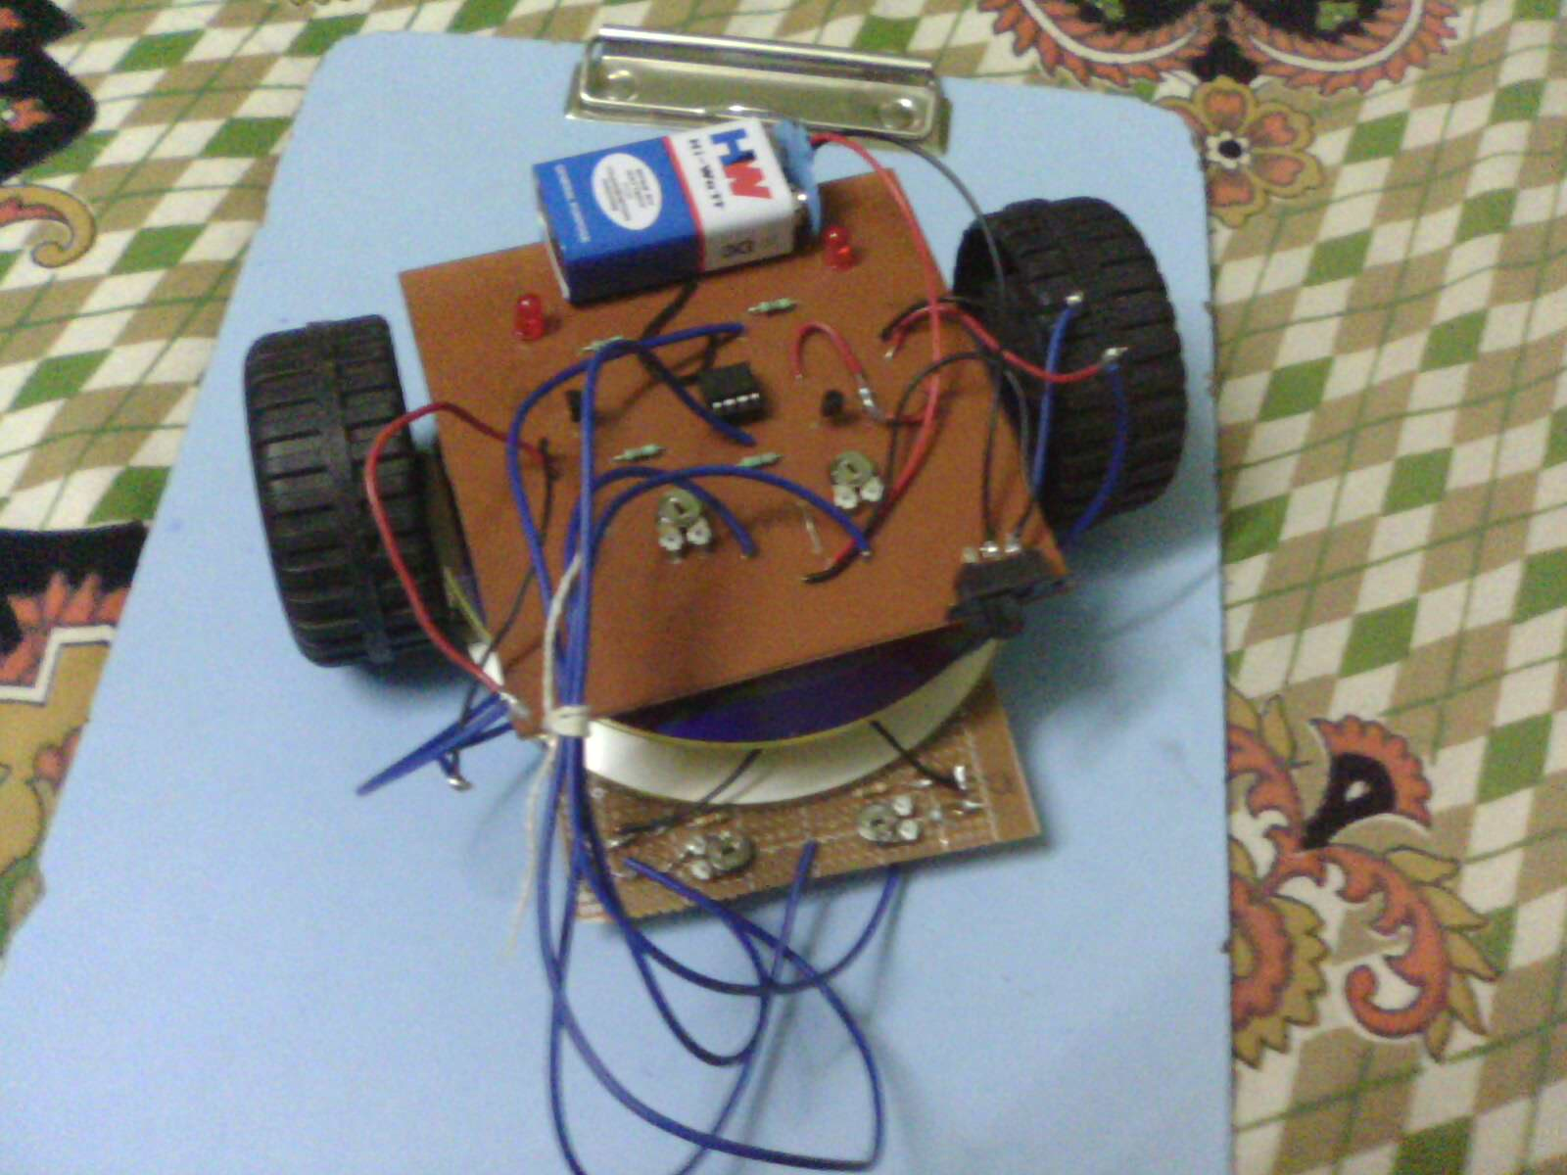
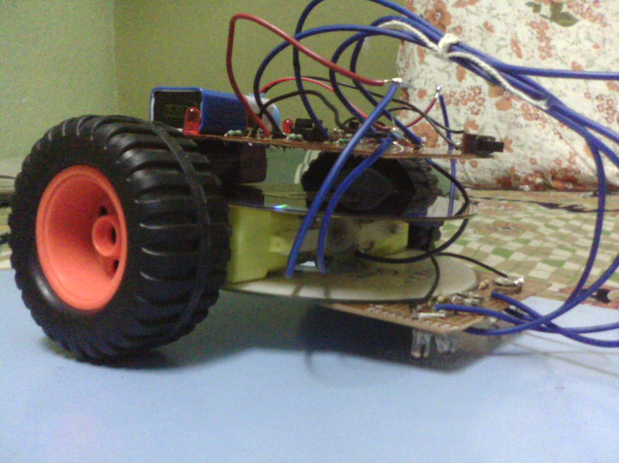
Making a body…

Slide 8
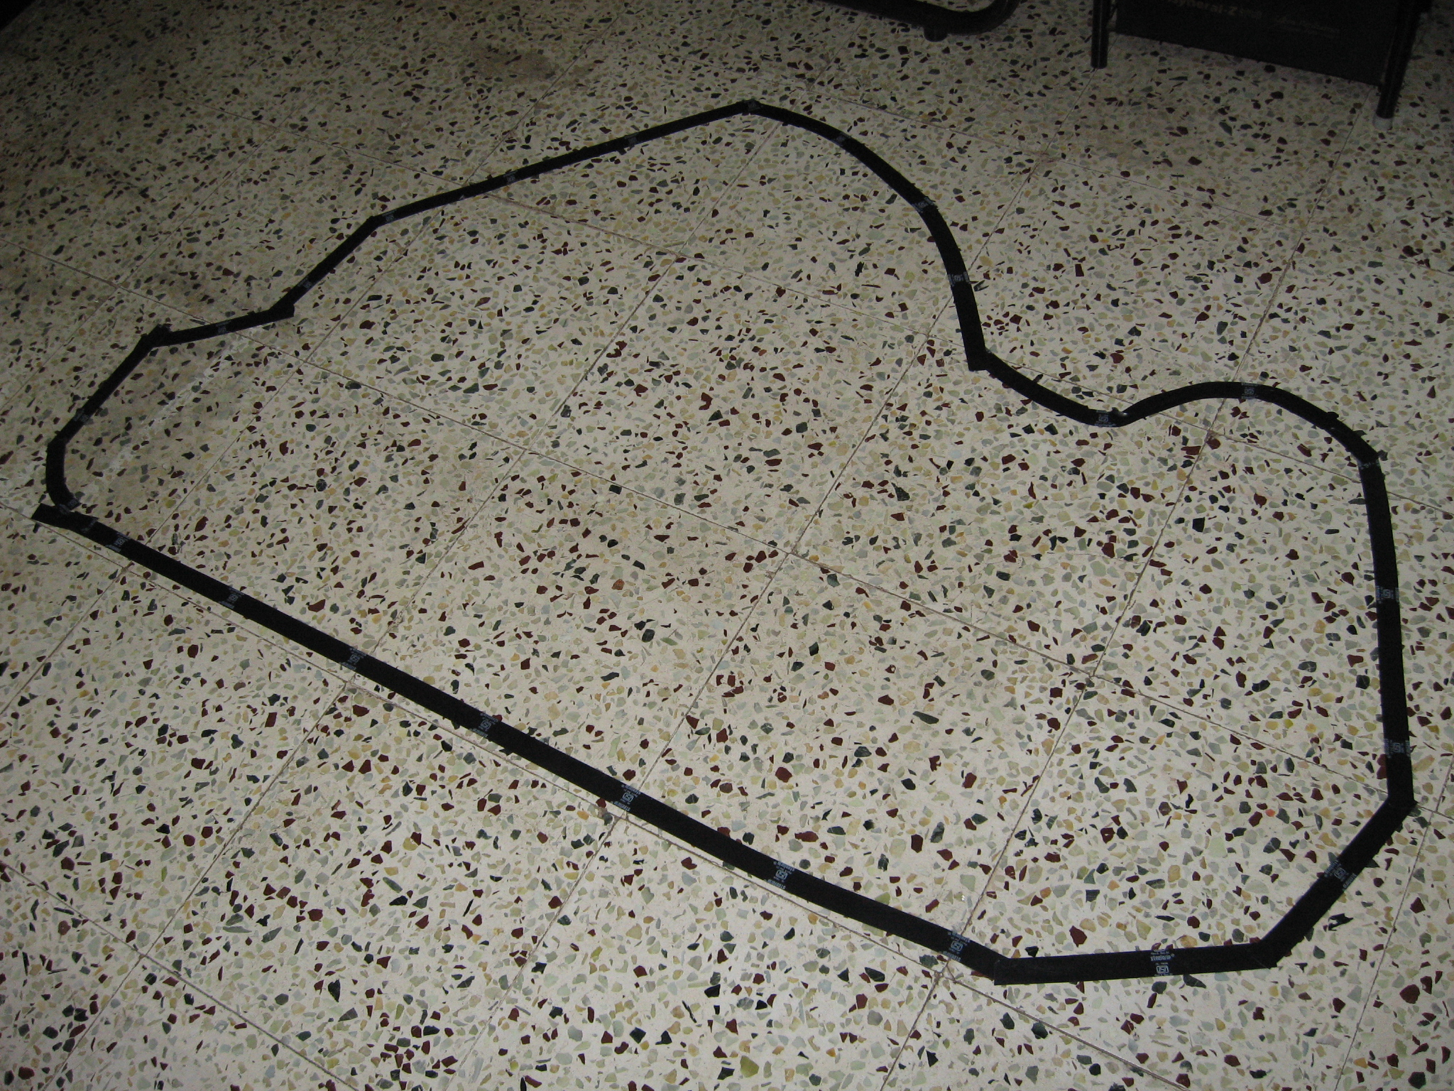
Creating the track

Slide 9
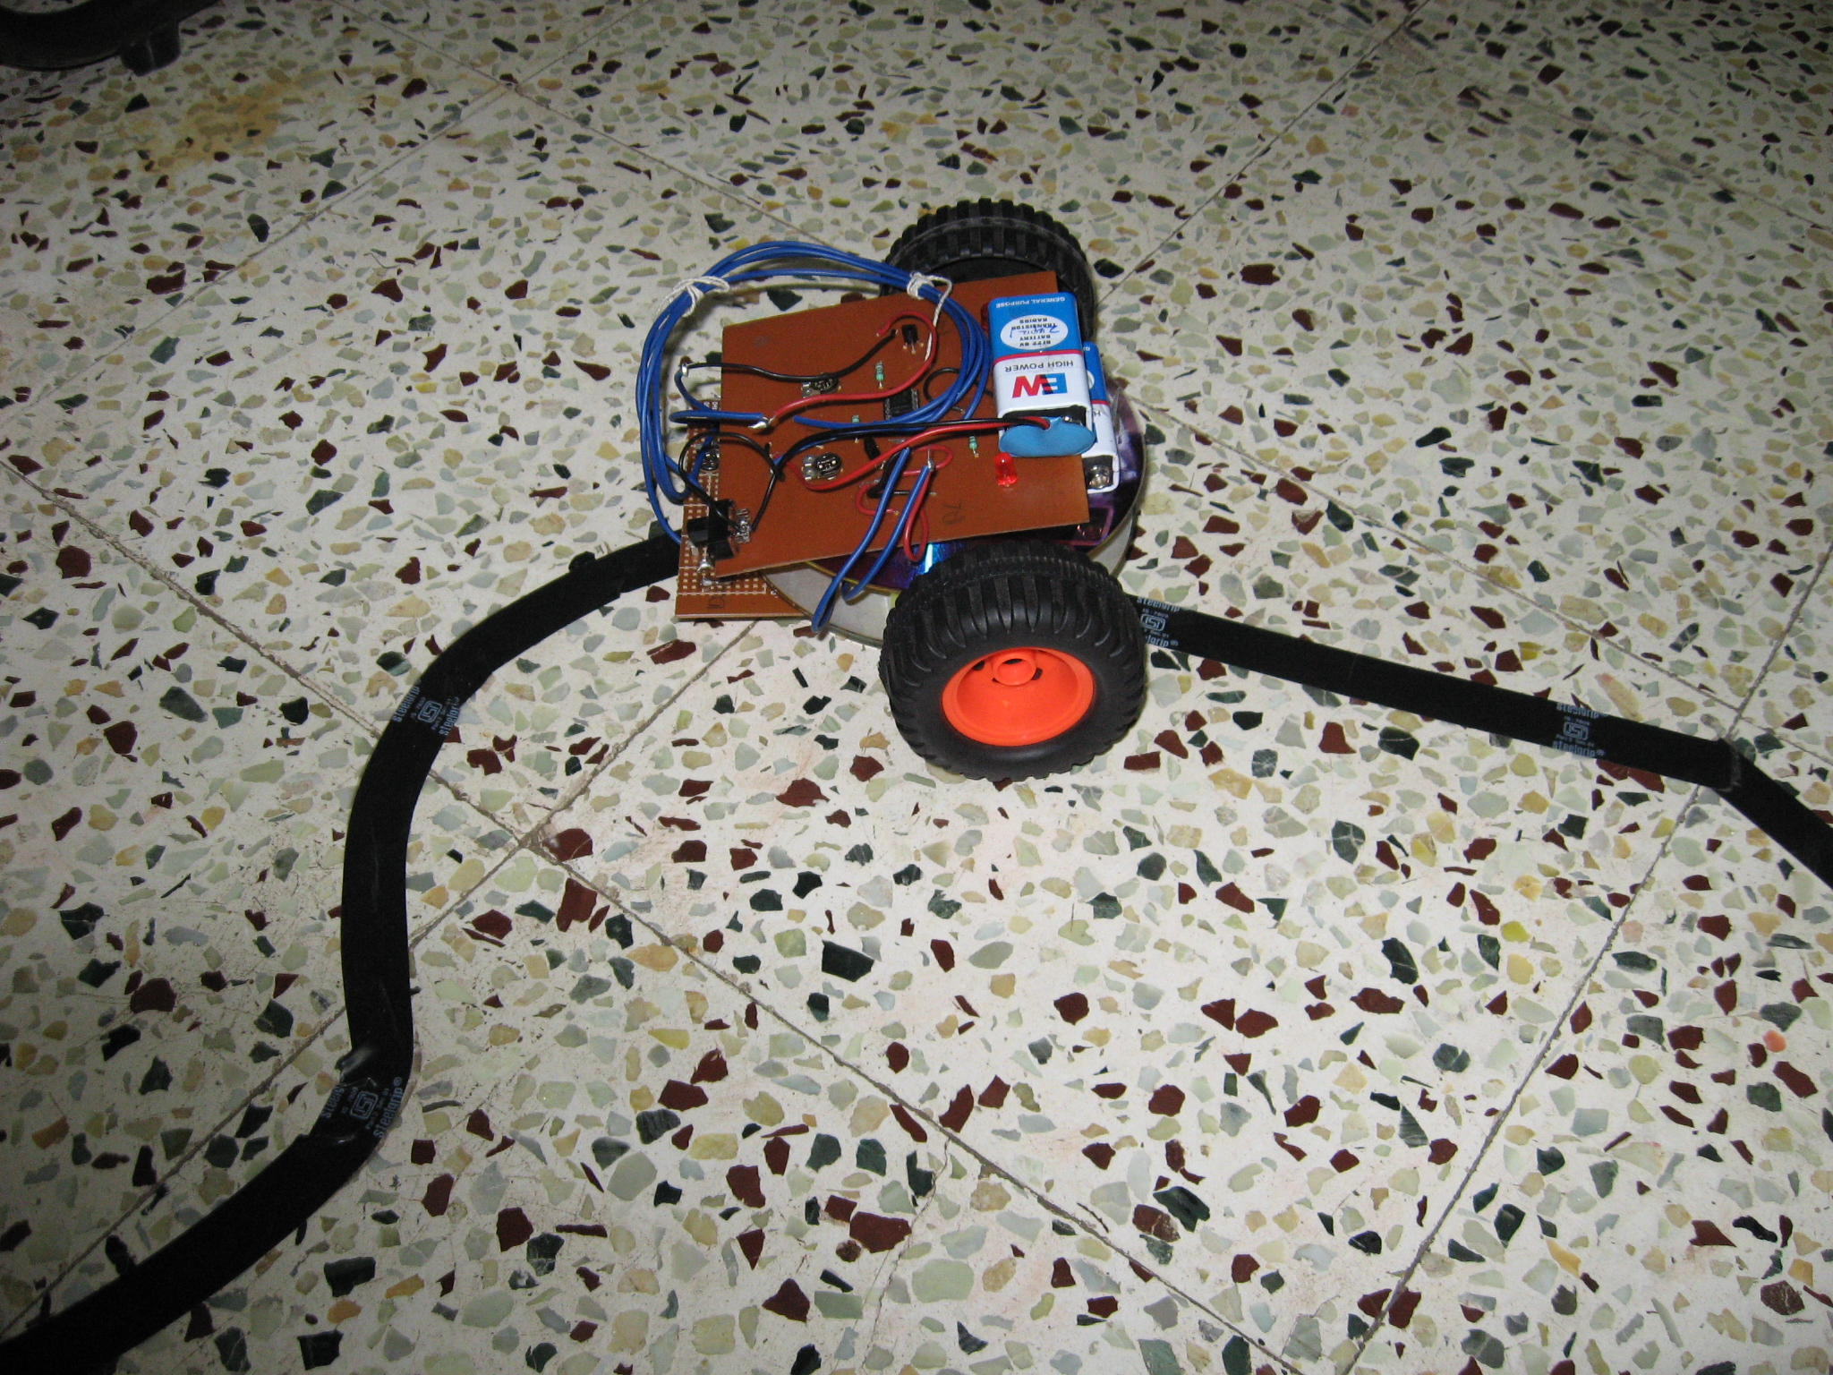
Testing…..

Slide 10
Thanks………..

